Slide 1
SQL Server Plan Caching and Query Store
Module 8

Slide 3
Learning Units covered in this Module
Lesson 1: SQL Server Plan Cache
Lesson 2: SQL Server Query Store

Slide 4
Lesson 1: SQL Server Plan Cache

Slide 5

Objectives
After completing this learning, you will be able to:
Describe the purpose and contents of the plan cache.
Query the plan cache using Dynamic Management Objects.
Discuss the pros and cons of plan reuse.
Explain why ad hoc SQL statements can be especially problematic.
Notes:
Block of SQL Server’s working set memory dynamically shared with the buffer pool.
Contains compiled and optimized query plans for reuse.
This is generally beneficial as creating query plans is costly both in time and CPU.
But, plan reuse isn’t always appropriate as when differing parameters yield results sets of widely varying sizes. Like, Nested Loop Joins are a cost-effective way to join smaller result sets, but are prohibitively expensive for very large result sets.
Ad hoc SQL statements are less likely to be reused as the text of subsequent SQL statements much match exactly to achieve reuse. This can bloat the plan cache with single-use plans. Address this by enabling the Optimize for ad hoc workloads server configuration option. Also use parameterized SQL and stored procedures in preference to ad hoc SQL.

Slide 6
The Plan Cache
A pool of memory used to store query execution plans
Used by all databases in a SQL Server instance
Exists to avoid repeated optimization and compilation
Size and contents vary over time.
Reuse of reduce optimization and compilation costs
With a fixed amount of memory, when the plan cache grows the buffer pool shrinks and vice-versa
SQL Server’s Memory
Plan
Cache
Buffer Pool
Other
Notes:
Maximum number of entries the plan cache can hold:
160,036 total entries
40,009 entries each for SQL Plans, Object Plans, Bound Trees, Extended SPs
Heavy ad hoc workloads may fill up the SQL Plans bucket and result in SOS_CACHESTORE spinlock contention.
This can be addressed with -T174 which increases the bucket count by 4X.
Maximum size the plan cache can reach:
75% of visible target memory from 0 to 4GB
+ 10% of visible target memory from 4GB to 64GB
+ 25% of visible target memory > 64GB
The “Optimize for ad hoc workload” server configuration option helps control the cache size.
When object plans are cached their compilation cost is noted. Under memory pressure that value is decremented. On plan reuse it is reset.
Ad hoc plans are cached with a cost of 0. This value is incremented on plan reuse.
Plans that have a cost of 0 may be evicted from the cache.

Slide 7
Plan Cache Contents
Object plans:
SQL Plans:
Other:
Granularity:
Stored procedures, functions, triggers
Prepared plans and ad hoc plans
Bound trees and extended stored procedure references
Execution plans are per-statement (not object).
Plans per Statement:
Multiple plans for a single statement may exist if differing execution contexts were used or if a parallel plan was generated.
Notes:
DMV – proc level stats
(Query to show contents by type)

Slide 8
Dynamic Management Views and Functions
Category | Description
sys.dm_exec_% | Execution and connection information
sys.dm_os_% | Operating system related information
sys.dm_tran_% | Transaction management information
sys.dm_io_% | I/O related information
sys.dm_db_% | Database information
Notes:
While all this has been running, several other parts of SQLOS have been active:
Monitoring: DMVs, Extended Events (xEvents), and so on.
Deadlock Monitor thread: Monitors for and deals with deadlocks.
Lazy Writer threads: Clock sweeping the buffer pool to maintain the free lists and responsible for writing dirty pages to disk between checkpoints.
Scheduler Monitor thread: Monitors scheduler health and detects issues such as non-yielding scenarios.
Resource Monitor thread: Monitors available memory from operating system and internal to SQL Server and notifies the Clerks.
The Hosting APIs for external components interface with Microsoft Data Access Components (MDAC) and common language runtime (CLR).

Slide 9
Dynamic Management Objects
sys.dm_exec_cached_plans
Plan type, size and handle
sys.dm_exec_query_stats
Execution metrics for individual statements
sys.dm_exec_query_plan()
Takes a plan_handle and returns the associated XML plan
sys.dm_exec_sql_text()
Takes a plan_handle or sql_handle and returns the associated SQL batch
Notes:
sys.dm_exec_cached_plans
https://docs.microsoft.com/en-us/sql/relational-databases/system-dynamic-management-views/sys-dm-exec-cached-plans-transact-sql?view=sql-server-ver15
sys.dm_exec_query_stats
https://docs.microsoft.com/en-us/sql/relational-databases/system-dynamic-management-views/sys-dm-exec-query-stats-transact-sql?view=sql-server-ver15
In addition to query-stats, consider the following stats:
sys.dm_exec_procedure_stats
https://docs.microsoft.com/en-us/sql/relational-databases/system-dynamic-management-views/sys-dm-exec-procedure-stats-transact-sql?view=sql-server-ver15
sys.dm_exec_trigger_stats
https://docs.microsoft.com/en-us/sql/relational-databases/system-dynamic-management-views/sys-dm-exec-trigger-stats-transact-sql?view=sql-server-ver15
sys.dm_exec_function_stats
https://docs.microsoft.com/en-us/sql/relational-databases/system-dynamic-management-views/sys-dm-exec-function-stats-transact-sql?view=sql-server-ver15
sys.dm_exec_query_plan()
https://docs.microsoft.com/en-us/sql/relational-databases/system-dynamic-management-views/sys-dm-exec-query-plan-transact-sql?view=sql-server-ver15
sys.dm_exec_sql_text()
https://docs.microsoft.com/en-us/sql/relational-databases/system-dynamic-management-views/sys-dm-exec-sql-text-transact-sql?view=sql-server-ver15

Slide 10
Relationships between DMOs
sys.dm_exec_cached_plans
plan_handle
sys.dm_exec_query_stats
plan_handle
plan_handle
or sql_handle
sys.dm_exec_query_plan()
sys.dm_exec_sql_text()

Slide 11
Captured Metrics (sys.dm_exec_query_stats )
Partial listing
Execution count
Worker time
Physical read
Logical reads
Memory consumption
Elapsed time
Row count
Spills
Aggregate statistics
Total
Last
Max
Min
Compute Average: Avg = Total / Execution count
Notes:
For the complete list see the sys.dm_exec_query_stats documentation:
https://docs.microsoft.com/en-us/sql/relational-databases/system-dynamic-management-views/sys-dm-exec-query-stats-transact-sql?view=sql-server-ver15

Slide 12
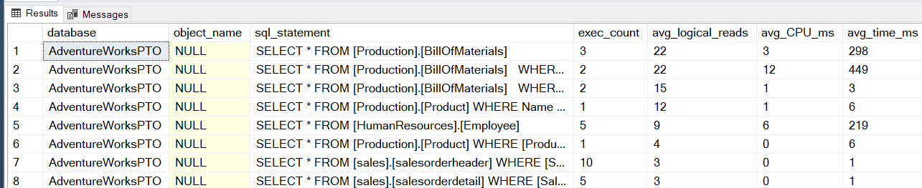
Mining the Plan Cache with T-SQL
Top 10 plans by logical reads
SELECT CASE st.dbid WHEN 32767 THEN 'resourcedb'
WHEN NULL THEN 'NA' ELSE DB_NAME(st.dbid)END AS [database], OBJECT_NAME(st.objectid) AS object_name,
SUBSTRING( st.text, ( qs.statement_start_offset / 2 ) + 1,
(( CASE qs.statement_end_offset WHEN -1 THEN DATALENGTH(st.text)
ELSE qs.statement_end_offset END - qs.statement_start_offset ) / 2 ) + 1) AS sql_statement,
qs.exec_count, qs.avg_logical_reads, qs.avg_CPU_ms, qs.avg_time_ms, qs.avg_logical_writes, qp.query_plan
FROM ( SELECT TOP ( 10 ) plan_handle, statement_start_offset, statement_end_offset,
execution_count AS exec_count,
total_worker_time / ( execution_count * 1000 ) AS avg_CPU_ms,
( total_elapsed_time / ( execution_count * 1000 )) AS avg_time_ms,
CASE WHEN total_logical_reads > 0 THEN ( total_logical_reads / execution_count )
ELSE 0 END AS avg_logical_reads,
CASE WHEN total_logical_writes > 0 THEN ( total_logical_writes / execution_count )
ELSE 0 END AS avg_logical_writes
FROM sys.dm_exec_query_stats
ORDER BY ( total_logical_reads / execution_count ) DESC ) AS qs
CROSS APPLY sys.dm_exec_sql_text(qs.plan_handle) st
CROSS APPLY sys.dm_exec_query_plan(qs.plan_handle) qp
ORDER BY qs.avg_logical_reads DESC
OPTION ( RECOMPILE );
Notes:
sys.dm_exec_sql_text() returns all the SQL statements in a batch.
The offset values from sys.dm_exec_query_stats are used to pick out the specific statement to which the plan and query stats apply.
Vary the ORDER BY statement in the displayed query to identify the TOP 10 queries by other measures:
ORDER BY execution_count DESC ) AS qs
ORDER BY ( total_logical_reads / execution_count ) DESC ) AS qs
ORDER BY (total_worker_time / execution_count ) DESC ) AS qs
ORDER BY ( total_elapsed_time / execution_count ) DESC ) AS qs
Etc.

Slide 13
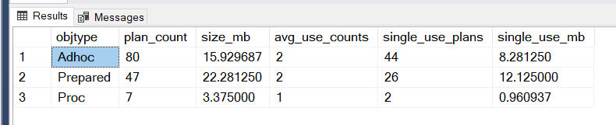
Cache Plan Bloat
Caused by ad hoc SQL
Heavy ad hoc workloads can bloat the plan cache
Enable “optimize for ad hoc workload” to keep single-use plans out of the cache
No benefit to caching single-use, ad hoc plans
-- Plan cache contents and memory use by object type
SELECT objtype, COUNT_BIG(*) AS plan_count, SUM(CAST(size_in_bytes AS DECIMAL(12, 2)))/(1024*1024) AS size_mb,
AVG(usecounts) AS avg_use_counts, SUM(CASE WHEN usecounts = 1 THEN 1 ELSE 0 END) AS single_use_plans,
SUM(CAST((CASE WHEN usecounts = 1 THEN size_in_bytes
ELSE 0 END) AS DECIMAL(12, 2)))/(1024*1024) AS single_use_mb
FROM sys.dm_exec_cached_plans
WHERE cacheobjtype = N'Compiled Plan'
GROUP BY objtype;
EXEC sp_configure 'optimize for ad hoc workload', 1;
GO
RECONFIGURE
GO
Notes:
optimize for ad hoc workloads Server Configuration Option
https://docs.microsoft.com/en-us/sql/database-engine/configure-windows/optimize-for-ad-hoc-workloads-server-configuration-option?view=sql-server-ver15
The optimize for ad hoc workloads option is used to improve the efficiency of the plan cache for workloads that contain many single use ad hoc batches. When this option is set to 1, the Database Engine stores a small compiled plan stub in the plan cache when a batch is compiled for the first time, instead of the full compiled plan. This helps to relieve memory pressure by not allowing the plan cache to become filled with compiled plans that are not reused.
The compiled plan stub allows the Database Engine to recognize that this ad hoc batch has been compiled before but has only stored a compiled plan stub, so when this batch is invoked (compiled or executed) again, the Database Engine compiles the batch, removes the compiled plan stub from the plan cache, and adds the full compiled plan to the plan cache.
Avoid having a large number of single-use plans in the plan cache. A common cause of this problem is when the data types of query parameters is not consistently defined. This particularly applies to the length of strings but can apply to any data type that has a maxlength, a precision, or a scale. For example, if a parameter named @Greeting is passed as an nvarchar(10) on one call and an nvarchar(20) on the next call, separate plans are created for each parameter size. If a query has several parameters and they are not consistently defined when called, a large number of query plans could exist for each query. Plans could exist for each combination of query parameter data types and lengths that have been used.

Slide 14
Clearing the Plan Cache
Not always the best option!
The entire plan cache – all databases
DBCC FREEPROCCACHE;
All plans of a specific type
DBCC FREESYSTEMCACHE ('SQL Plans');
All plans for a single database
ALTER DATABASE SCOPED CONFIGURATION CLEAR PROCEDURE_CACHE;
A specific plan
ALTER DATABASE SCOPED CONFIGURATION CLEAR PROCEDURE_CACHE(<plan_handle>);
Performance impact as new plans are compiled
Notes:
DBCC FREEPROCCACHE [ ( { plan_handle | sql_handle | pool_name } ) ] [ WITH NO_INFOMSGS ]
https://docs.microsoft.com/en-us/sql/t-sql/database-console-commands/dbcc-freeproccache-transact-sql?view=sql-server-ver15
Removes all elements from the plan cache, removes a specific plan from the plan cache by specifying a plan handle or SQL handle, or removes all cache entries associated with a specified resource pool.
DBCC FREESYSTEMCACHE ( 'ALL' [, pool_name ] ) [WITH { [ MARK_IN_USE_FOR_REMOVAL ] , [ NO_INFOMSGS ] } ]
https://docs.microsoft.com/en-us/sql/t-sql/database-console-commands/dbcc-freesystemcache-transact-sql?view=sql-server-ver15
Releases all unused cache entries from all caches – not just the plan cache. Using the ‘SQL Plans’ parameter will flush both ad hoc and prepared plans from the cache.

Slide 15
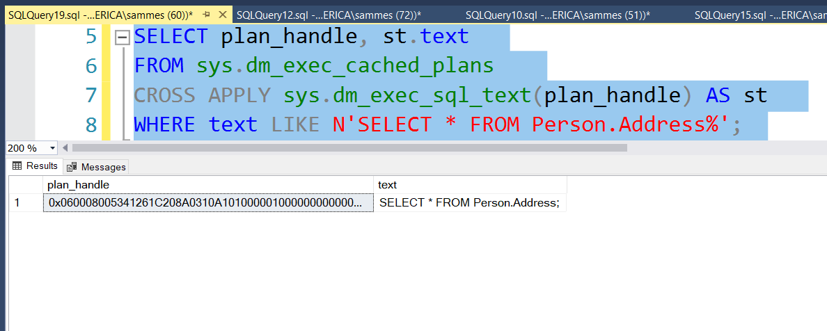
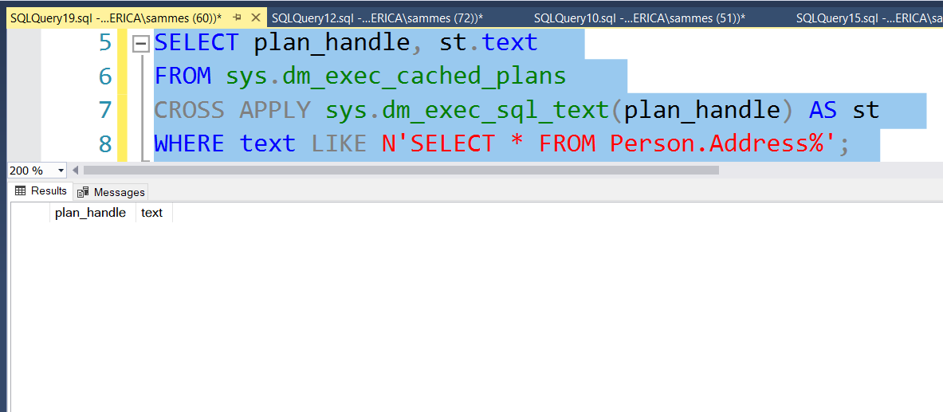
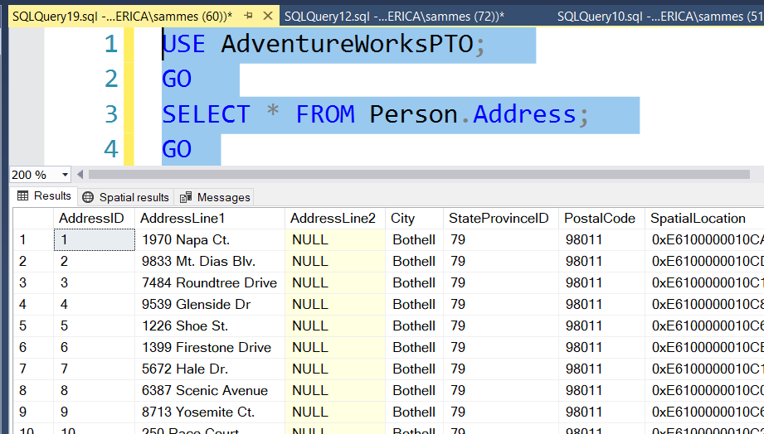
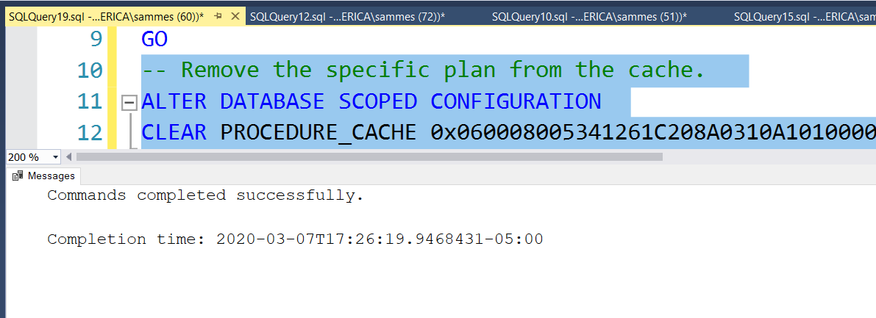
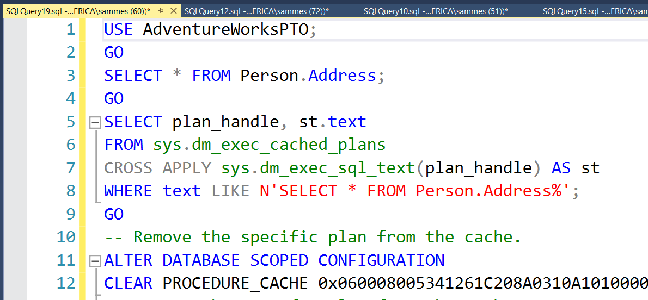
Clearing the Plan Cache
Not your first option!
The entire plan cache – all databases
ALTER DATABASE SCOPED CONFIGURATION CLEAR PROCEDURE_CACHE;
All plans of a specific type
DBCC FREESYSTEMCACHE ('SQL Plans’);
All plans for a single database
ALTER DATABASE SCOPED CONFIGURATION CLEAR PROCEDURE_CACHE;
A specific plan
ALTER DATABASE SCOPED CONFIGURATION CLEAR PROCEDURE_CACHE <plan_handle>;
Performance impact as new plans are compiled
Notes:
-- SAMPLE CODE:
-- for 1 QUERY USE AdventureWorksPTO;
GO
SELECT * FROM Person.Address;
GO
SELECT plan_handle, st.text
FROM sys.dm_exec_cached_plans
CROSS APPLY sys.dm_exec_sql_text(plan_handle) AS st
WHERE text LIKE N'SELECT * FROM Person.Address%';
GO
-- Remove the specific plan from the cache.
ALTER DATABASE SCOPED CONFIGURATION
CLEAR PROCEDURE_CACHE 0x060008005341261C208A0310A101000001000000000000000000000000000000000000000000000000000000;
-- Remove the specific plan from the cache.
DBCC FREEPROCCACHE (0x060008005341261C208A0310A101000001000000000000000000000000000000000000000000000000000000);
GO
-- for all queries for the database:
USE AdventureWorksPTO;
GO
SELECT * FROM Person.Address;
GO
SELECT * FROM Person.Address WHERE addressId = 2;
GO
SELECT * FROM Person.Address WHERE StateProvinceID=79;
GO
SELECT plan_handle, st.text
FROM sys.dm_exec_cached_plans
CROSS APPLY sys.dm_exec_sql_text(plan_handle) AS st
WHERE text LIKE N'SELECT * FROM Person.Address%';
GO
-- REMOVE all plans for database
ALTER DATABASE SCOPED CONFIGURATION CLEAR PROCEDURE_CACHE;
DBCC FREEPROCCACHE [ ( { plan_handle | sql_handle | pool_name } ) ] [ WITH NO_INFOMSGS ]
https://docs.microsoft.com/en-us/sql/t-sql/database-console-commands/dbcc-freeproccache-transact-sql?view=sql-server-ver15
Removes all elements from the plan cache, removes a specific plan from the plan cache by specifying a plan handle or SQL handle, or removes all cache entries associated with a specified resource pool.
DBCC FREESYSTEMCACHE ( 'ALL' [, pool_name ] ) [WITH { [ MARK_IN_USE_FOR_REMOVAL ] , [ NO_INFOMSGS ] } ]
https://docs.microsoft.com/en-us/sql/t-sql/database-console-commands/dbcc-freesystemcache-transact-sql?view=sql-server-ver15
Releases all unused cache entries from all caches – not just the plan cache. Using the ‘SQL Plans’ parameter will flush both ad hoc and prepared plans from the cache.

Slide 16
Plan Reuse
Requires that SQL statements match exactly
Any difference in casing, white space or literal values will affect a hashed value
Less likely for ad hoc SQL statements
Simple (on by default) or Forced Parameterization can improve reuse
Most easily achieved using:
Stored procedures, Functions, Triggers
Prepared statements and parameterized queries (sp_executesql)
-- Small changes in case or white space yield differing hashes
SELECT HASHBYTES('MD5','SELECT * FROM Person.Person') UNION ALL
SELECT HASHBYTES('MD5','SELECT * FROM person.Person') UNION ALL
SELECT HASHBYTES('MD5','SELECT * FROM Person.Person')
/*
0xF2D4F28DA93156A5BB487B019F1F0191
0x76F700BB3DC09FF482E1E4A77C7392E8
0xB1D875A858F4D410D9E866C40E523683
*/
Notes:
ALTER DATABASE SET PARAMETERIZATION { SIMPLE | FORCED };
https://docs.microsoft.com/en-us/sql/t-sql/statements/alter-database-transact-sql-set-options?view=sql-server-ver15
Simple Parameterization
https://docs.microsoft.com/en-us/sql/relational-databases/query-processing-architecture-guide?view=sql-server-ver15#SimpleParam
Forced Parameterization
https://docs.microsoft.com/en-us/sql/relational-databases/query-processing-architecture-guide?view=sql-server-ver15#ForcedParam
How Simple Parameterization works
https://docs.microsoft.com/en-us/archive/blogs/psssql/how-simple-parameterization-works
Simple parameterization is enabled by default. Check the StatementParameterizationType attribute value in an actual execution plan to see whether parameterization applied. The values are documented in sys.query_store_query:
0 = None
1 = User
2 = Simple
3 = Forced
Note the use (and value of) UNION ALL compared to UNION (which has an implicit DISTINCT)

Slide 17
Plan Reuse
Improved performance as reuse saves time and CPU
Degraded performance when reused plan is not optimal for all parameter values
Benefit
Drawback
Parameter Sniffing
Optimizer’s ability to see (sniff) parameter values at compile time and so create a cost-effective execution plan.
Recompile hints
Prevent caching of plans at the object or statement (preferred) level
sp_recompile <object_name> to manually force recompilation
Only problematic when compile parameters aren’t representative
This is generally beneficial.
Notes:
https://docs.microsoft.com/en-us/sql/t-sql/queries/hints-transact-sql-query?view=sql-server-ver15
OPTION(RECOMPILE) query hint Instructs the SQL Server Database Engine to generate a new, temporary plan for the query and immediately discard that plan after the query completes execution. The generated query plan doesn't replace a plan stored in cache when the same query runs without the RECOMPILE hint. Without specifying RECOMPILE, the Database Engine caches query plans and reuses them. When compiling query plans, the RECOMPILE query hint uses the current values of any local variables in the query. If the query is inside a stored procedure, the current values passed to any parameters.
https://docs.microsoft.com/en-us/sql/t-sql/statements/create-procedure-transact-sql?view=sql-server-ver15
CREATE PROC dbo.MyProc WITH RECOMPILE Indicates that the Database Engine does not cache a query plan for this procedure, forcing it to be compiled (all statements) each time it is executed.
Use of the statement-level OPTION (RECOMPILE) hint is preferred.
sp_recompile
https://docs.microsoft.com/en-us/sql/relational-databases/system-stored-procedures/sp-recompile-transact-sql?view=sql-server-ver15

Slide 18
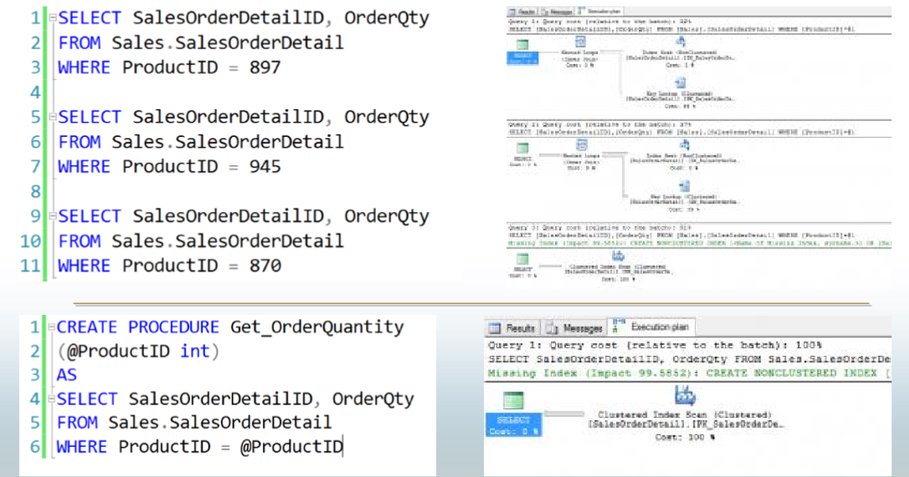
Parameter Sniffing
Notes:
When a parameterized batch or stored procedure is compiled for the first time, the values of the parameters supplied with the execution call are used to optimize the statements. This process is known as parameter sniffing. If these values are typical, then most calls to that stored procedure will benefit from an efficient query plan.
CREATE PROCEDURE testProc @p1 int = null
AS
BEGIN
If @p1 IS NULL
Begin
Select @p1 = 9999
End
SELECT *
FROM sales.target
WHERE amount = @p1
END
Issues generally arise in two scenarios:
The sniffed parameter value is not typical of the values that are actually used during a typical execution.
The parameter is changed within a stored procedure before it is used in a query-parameterized queries will behave in a similar manner to batches that have been explicitly parameterized. That is, if the first execution of a query uses an atypical value when it is compiled, similar queries that share the execution plan through simple or forced parameterization may have inaccurate cardinality estimates.
Repeat of previous page

Slide 19

Demonstration
Caching and Parameter sniffing
Caching and reuse of ad hoc vs. stored procedure query plans
Parameter sniffing
Querying the plan cache
Notes:
M08L01Demo01
Walk through the following demos:
E:\Demos\M08L01Demo01\Demo1_adhoc_vs_proc_plans.sql
E:\Demos\M08L01Demo01\Demo2_parameter_sniffing.sql
E:\Demos\M08L01Demo01\Demo3_querying_the_plan_cache_DMOs.sql

Slide 20

Questions?

Slide 21
Knowledge Check
Is the size of the plan cache fixed?
How long do query plans remain in the plan cache?
Why is plan caching helpful?
Why are ad hoc query plans sometimes problematic?
What can be done to address a parameter sniffing issue?
What can be done to lessen the impact of an ad hoc workload?
Notes:
Q1) Is the size of the plan cache fixed?
A1) No. It grows on demand, within limits, and can shrink when there’s memory pressure.
Q2) How long do query plans remain in the plan cache?
A2) Until memory pressure forces them out.
Q3) Why is plan caching helpful?
A3) Plan reuse saves time and CPU since a new plan needn’t be compiled every time a statement is executed.
Q4) Why are ad hoc query plans sometimes problematic?
A4) They are often single-use both because of their nature (users browsing data) and because small changes in SQL text impact the ability of the Optimizer to match current queries to cached plans. This can lead to filling up the plan cache with plans that will never be reused – a waste of space that may negatively impact the size of the buffer pool.
Q5) What can be done to lessen the impact of an ad hoc workload?
A5) Address this by enabling the “optimize for ad hoc workload” server configuration item. This prevents full caching of plans until they’ve been used a second time.
Q6) What can be done to address a parameter sniffing issue?
A6) You can use statement-level recompile hints to ensure you have cost-effective plans for all executions of a statement. Recompile hints simply prevent caching of the query plans for statements in their scope (object or statement).

Slide 22
Lesson 2: SQL Server Query Store

Slide 23
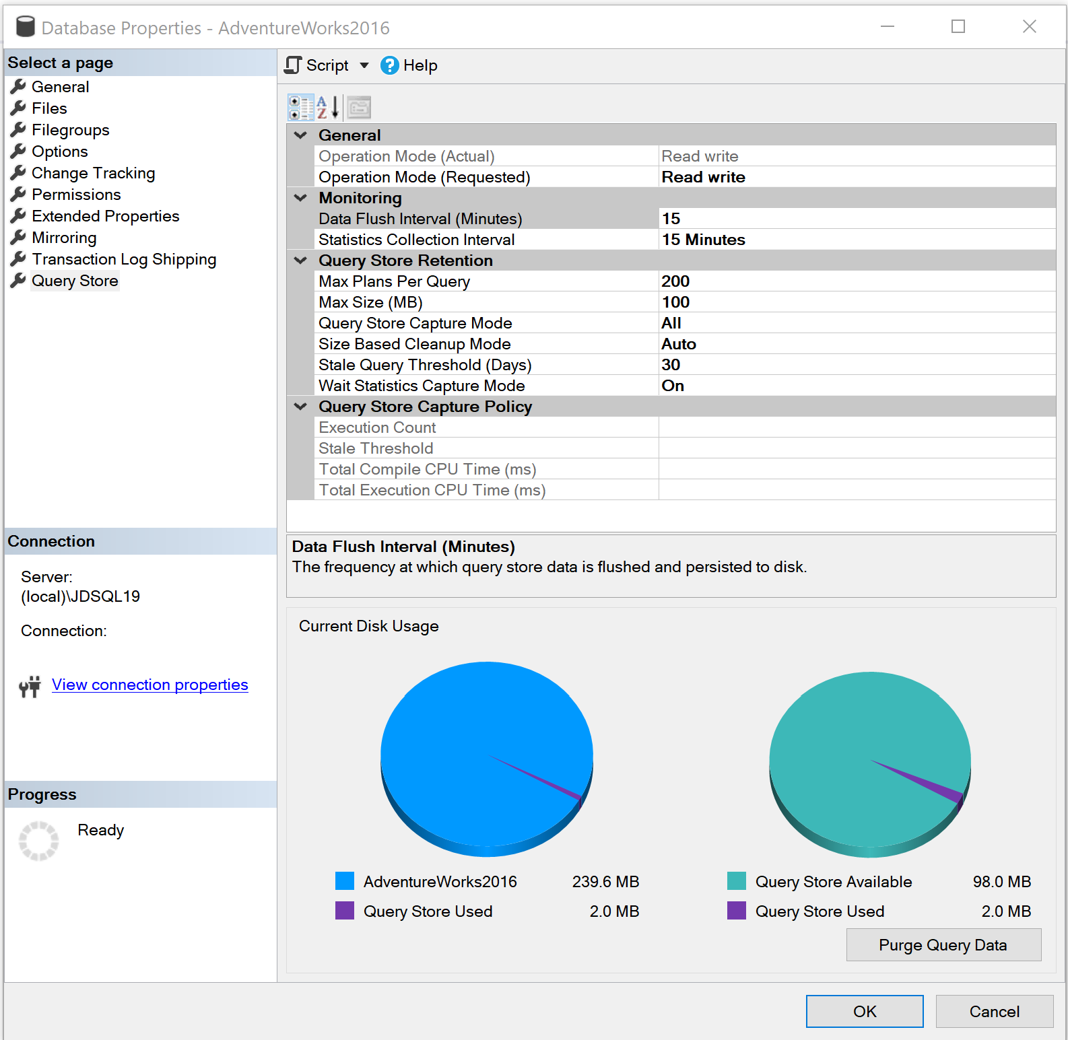
Introducing the Query Store
Query Store is set at the database level
Cannot be used for Master or TempDB system databases but can be enabled for the Model and MSDB system databases.
The user database stores the data in internal tables that can be accessed by using built-in Query Store views.
SQL Server retains this data until the space allocated to Query Store is full or manually purged.
Notes:
Please consider editing or deleting “Give me the top queries that have changed in performance compared to the number of executions. “

Slide 24
Why use Query Store?
Before Query Store
Requires manual proactive monitoring to identify execution plan problems.
Only the latest plan was stored in the procedure cache
Restart caused data to be lost
No history or aggregated gathering of data available.
Frequent recompiles of procedures or use of DBCC FREEPROCACHE
It works across server restarts, upgrades, and query recompilation
With Query Store
It stores the history of the execution plans for each query
It establishes a performance baseline for each plan over time
It identifies queries that may have regressed
It is possible to force plans quickly and easily
Notes:
Parameter-sensitive? GLOBAL query
GLOBAL: Do not capitalize generic terms. Please note that we do not capitalize terms unless they are from the UI or are feature or product names. Please consider lowercasing such terms throughout this document.
GLOBAL: Please avoid using first person (“we”, “I”) Always use “you” or “Microsoft” if that is applicable.
…have a lot of …?

Slide 25
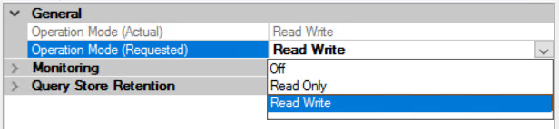

Query Store Operation Modes
Operation Mode can be set under database properties
Operation Mode can be enabled two ways using T-SQL. If only using the ON option, the Mode defaults to Read_Write

Slide 26
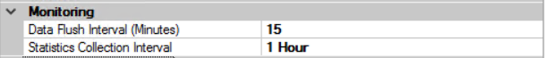
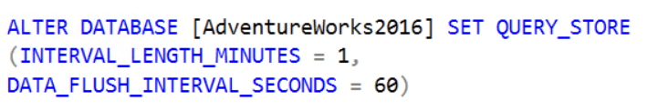
Query Store Monitoring Settings
Data Flush Interval determines the frequency at which data written to the query store is persisted to disk. (Default is 15 Minutes).

Slide 27
Query Store Monitoring Settings
Statistics Collection Interval determines the time interval at which runtime execution statistics data is aggregated into the query store. Only the values of 1, 5, 10, 15, 60, and 1440 minutes is allowed. (Default is 60).

Slide 28
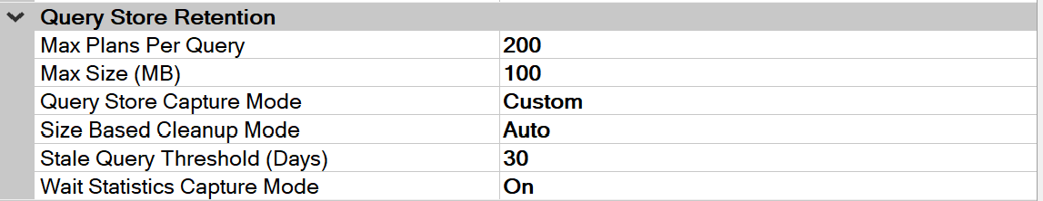
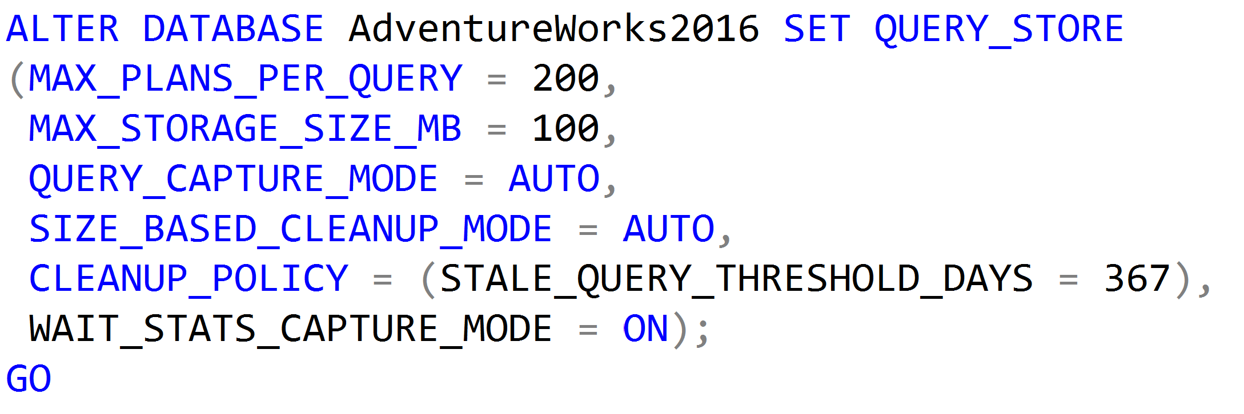
Query Store Retention Settings
Max Plans Per Query is a new retention setting introduced in SQL Server 2017 and is an integer representing the maximum number of plans maintained for each query. (Default is 200).

Slide 29
Query Store Retention Settings
Max Size (MB) configures the maximum storage size for the query store. (Default is 100MB) When the query store limit is reached, query store changes the state from read-write to read-only.

Slide 30
Query Store Retention Settings
Query Store Capture Mode determines to capture all the queries (Default is ALL), or relevant queries based on execution count and resource consumption (AUTO) or stop capturing queries (NONE). SQL Server 2019 introduces an additional (CUSTOM) setting.

Slide 31
Query Store Retention Settings
Size Based Cleanup Mode determines whether the cleanup process will be automatically activated when the total amount of data gets close to the maximum size. (Default is Auto).

Slide 32
Query Store Retention Settings
Stale Query Threshold (Days) determines the number of days to retain data in the query store. (Default is 30 days and Maximum is 367 days).

Slide 33
Query Store Retention Settings
Wait Statistics Capture Mode is a new retention setting introduced in SQL Server 2017 that controls if Query Store captures wait statistics information.
(Default = ON).

Slide 34
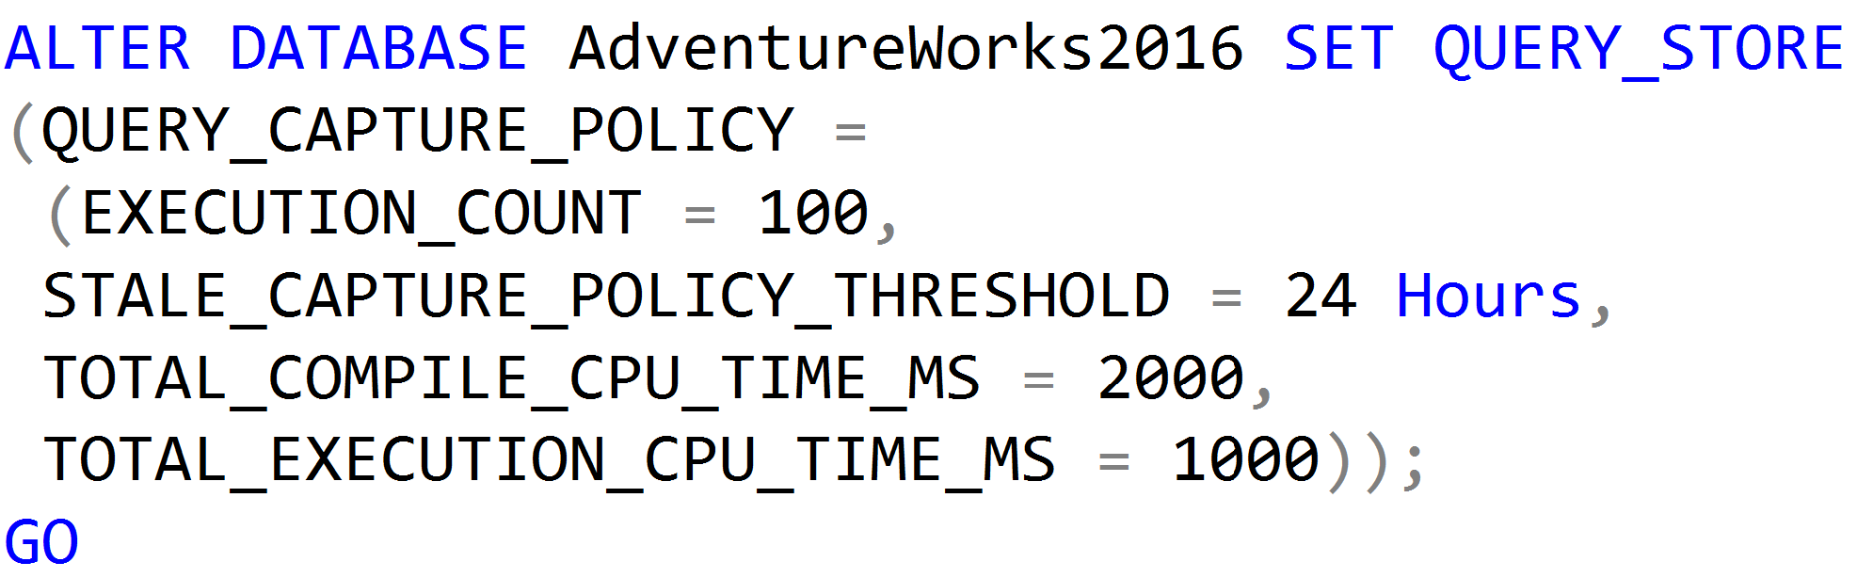
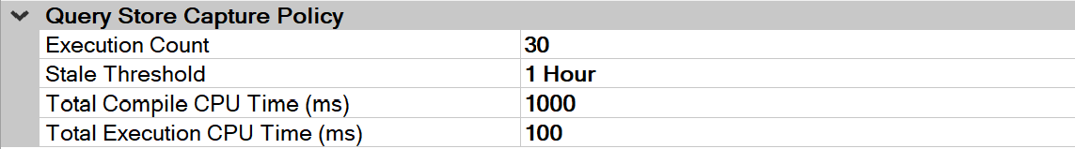
Query Store Capture Policy Settings
Introduced in SQL Server 2019 and available if the Query Store Capture Mode setting has been set to CUSTOM.
The value for the EXECUTION COUNT is the value a query must exceed within the Stale Threshold time period to be captured by the Query Store.

Slide 35
Query Store Capture Policy Settings
Introduced in SQL Server 2019 and available if the Query Store Capture Mode setting has been set to CUSTOM.
The value for the Stale Threshold can be from 1 hour up to 7 days. This setting specifies the time given to exceed the values of the three other settings for a query to be captured.

Slide 36
Query Store Capture Policy Settings
Introduced in SQL Server 2019 and available if the Query Store Capture Mode setting has been set to CUSTOM.
The value for the Total Compile CPU Time (ms) is the value in milliseconds that a query must exceed within the Stale Threshold time period to be captured by the Query Store.

Slide 37
Query Store Capture Policy Settings
Introduced in SQL Server 2019 and available if the Query Store Capture Mode setting has been set to CUSTOM.
The value for the Total Execution CPU Time (ms) is the value in milliseconds that a query must exceed within the Stale Threshold time period to be captured by the Query Store.

Slide 38
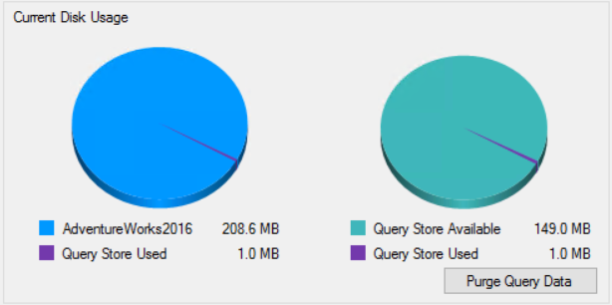
Purge Query Data
Data can be manually purged from the Query Store.

Slide 39
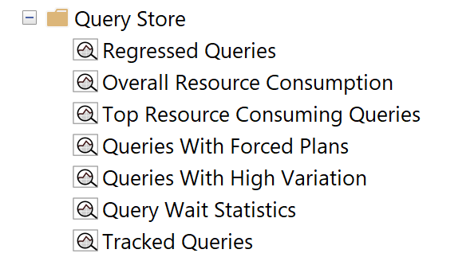
Query Store Reports
Regressed Queries: Use this dashboard to review queries that might have regressed because of execution plan changes
Notes:
Parameter-sensitive? GLOBAL query
GLOBAL: Do not capitalize generic terms. Please note that we do not capitalize terms unless they are from the UI or are feature or product names. Please consider lowercasing such terms throughout this document.
GLOBAL: Please avoid using first person (“we”, “I”) Always use “you” or “Microsoft” if that is applicable.
…have a lot of …?

Slide 40
Query Store Reports
Overall Resource Consumption: Use this dashboard to visualize overall resource consumption during the last month in four charts: duration, execution count, CPU time, and logical reads
Notes:
Parameter-sensitive? GLOBAL query
GLOBAL: Do not capitalize generic terms. Please note that we do not capitalize terms unless they are from the UI or are feature or product names. Please consider lowercasing such terms throughout this document.
GLOBAL: Please avoid using first person (“we”, “I”) Always use “you” or “Microsoft” if that is applicable.
…have a lot of …?

Slide 41
Query Store Reports
Top Resource Consuming Queries: Use this dashboard to review queries in the set of top 25 resource consumers during the last hour
Notes:
Parameter-sensitive? GLOBAL query
GLOBAL: Do not capitalize generic terms. Please note that we do not capitalize terms unless they are from the UI or are feature or product names. Please consider lowercasing such terms throughout this document.
GLOBAL: Please avoid using first person (“we”, “I”) Always use “you” or “Microsoft” if that is applicable.
…have a lot of …?

Slide 42
Query Store Reports
Queries With Forced Plans: Used to isolate queries that have been given a forced plan. Requires SQL Server 2016 SP1 or later.
Notes:
Parameter-sensitive? GLOBAL query
GLOBAL: Do not capitalize generic terms. Please note that we do not capitalize terms unless they are from the UI or are feature or product names. Please consider lowercasing such terms throughout this document.
GLOBAL: Please avoid using first person (“we”, “I”) Always use “you” or “Microsoft” if that is applicable.
…have a lot of …?

Slide 43
Query Store Reports
Queries With High Variation: Used to locate queries with high variation in query execution. Useful to locate queries with parameterization problems. Requires SQL Server 2016 SP1 or later.
Notes:
Parameter-sensitive? GLOBAL query
GLOBAL: Do not capitalize generic terms. Please note that we do not capitalize terms unless they are from the UI or are feature or product names. Please consider lowercasing such terms throughout this document.
GLOBAL: Please avoid using first person (“we”, “I”) Always use “you” or “Microsoft” if that is applicable.
…have a lot of …?

Slide 44
Query Store Reports
Query Wait Statistics shows a bar chart containing the top wait categories in the Query Store. Use the drop down at the top to select an aggregate criteria for the wait time: avg, max, min, std dev, and total (default). Requires SQL Server 2017.
Notes:
Parameter-sensitive? GLOBAL query
GLOBAL: Do not capitalize generic terms. Please note that we do not capitalize terms unless they are from the UI or are feature or product names. Please consider lowercasing such terms throughout this document.
GLOBAL: Please avoid using first person (“we”, “I”) Always use “you” or “Microsoft” if that is applicable.
…have a lot of …?

Slide 45
Query Store Reports
Tracked Queries: Use this dashboard to monitor the execution plans and regression of a specify query
Notes:
Parameter-sensitive? GLOBAL query
GLOBAL: Do not capitalize generic terms. Please note that we do not capitalize terms unless they are from the UI or are feature or product names. Please consider lowercasing such terms throughout this document.
GLOBAL: Please avoid using first person (“we”, “I”) Always use “you” or “Microsoft” if that is applicable.
…have a lot of …?

Slide 46
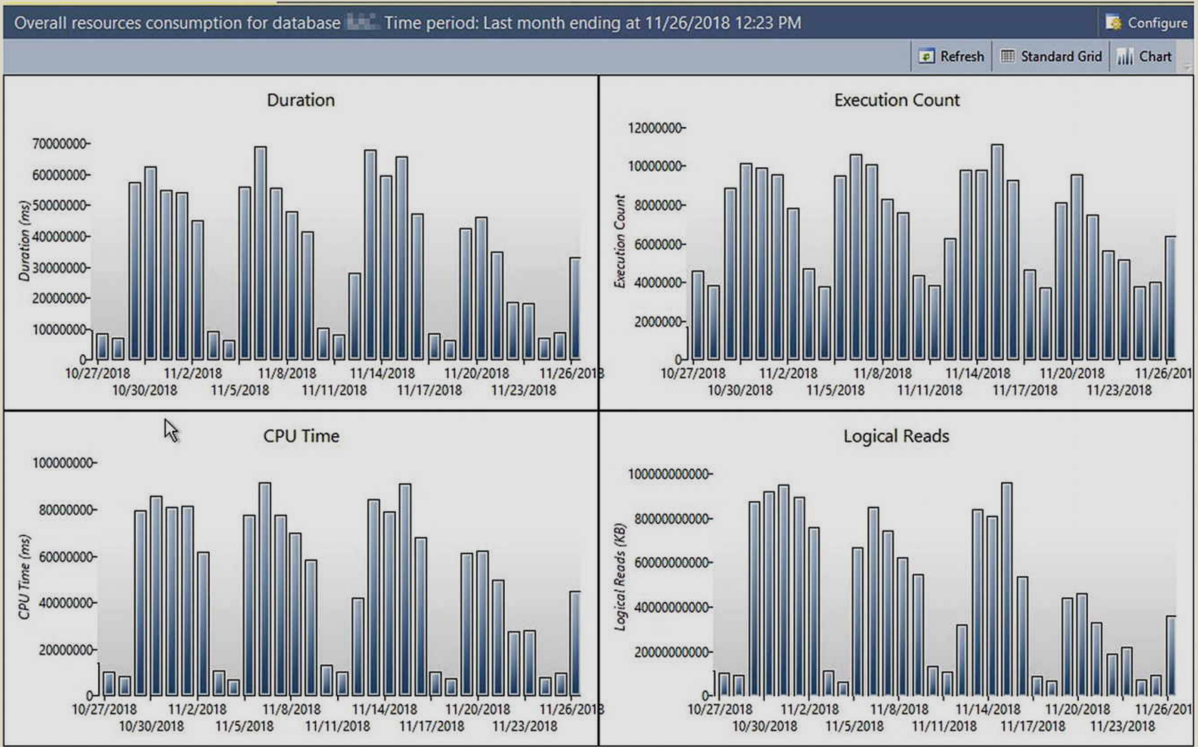
Establishing a Baseline
Notes:
Picture provide by Tracy Boggiano from her book Query Store for SQL Server 2019.
GLOBAL: Please avoid using first person (“we”, “I”) Always use “you” or “Microsoft” if that is applicable.

Slide 47
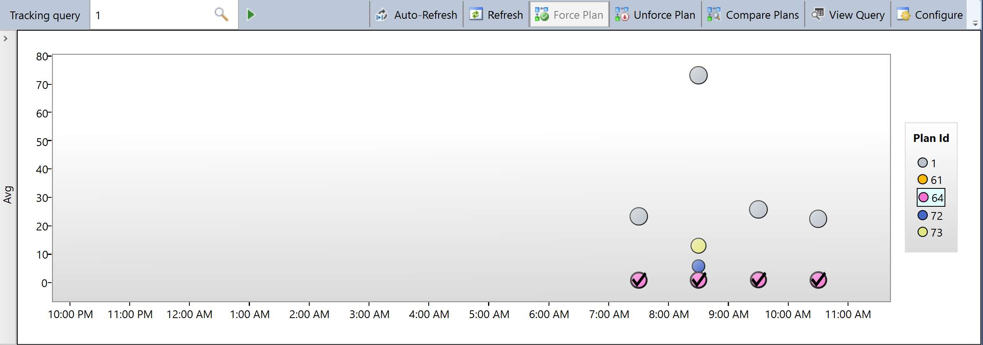
Force Plan
Notes:
GLOBAL: Please avoid using first person (“we”, “I”) Always use “you” or “Microsoft” if that is applicable.

Slide 48
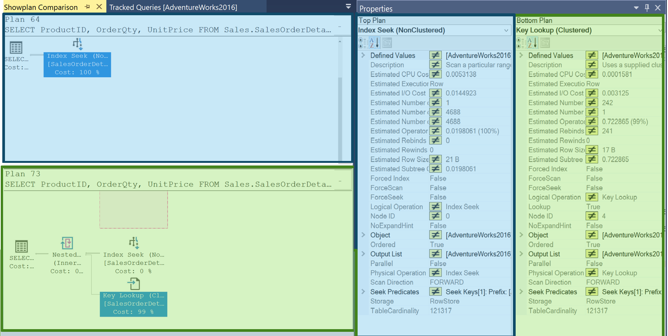
Plan Compare
Notes:
What version does “Before” refer to?
“query store compare plans was a complicated ” is unclear – please revisit.

Slide 49
Query Store Catalog Views
sys.query_store_query_text
 | query_text_id
 | query_sql_text
sys.query_store_query
 | query_id
 | query_text_id
 | context_settings_id
sys.query_store_plan
 | plan_id
 | query__id
sys.query_context_settings
 | context_settings_id
sys.query_store_wait_stats
 | waits_stats_id
 | plan_id
 | runtime_stats_interval_id
sys.query_store_runtime_stats
 | plan_id
 | runtime_stats_interval_id
Query Store Information
sys.query_store_runtime_stats_interval
 | runtime_stats_interval_id
 | start_time
 | End_time
Compile Time Information

Slide 50
Using Query Store Catalog Views
Finding the TOP 10 most frequently executed SQL Server Queries in the Query Store.
SELECT TOP 10 t.query_sql_text, q.query_id
FROM sys.query_store_query_text as t
JOIN sys.query_store_query as q
ON t.query_text_id = q.query_text_id
JOIN sys.query_store_plan as p
ON q.query_id = p.query_id
JOIN sys.query_store_runtime_stats as rs
ON p.plan_id = rs.plan_id
WHERE rs.count_executions >1
GROUP BY t.query_sql_text, q.query_id
ORDER BY SUM(rs.count_executions)

Slide 51

Troubleshooting Using the Query Store
Notes:
M08L03Lab01

Slide 52
Questions?

Slide 53
Knowledge Check
If upgrading from SQL Server 2012 to 2019. Which report should figure prominently in your upgrade plans?
In a report’s bar chart what does each bar represent?
Which report can help troubleshoot a parameter sniffing issue?
Querying the wait statistics DMV it returns high PAGEIOLATCH waits. Which report can help identify queries with high IO wait times?
Someone has dropped an index needed by a forced plan. What happens the next time the query executes? What happens if the index is recreated?
Notes:
Q1) If upgrading from SQL Server 2012 to 2019. Which report should figure prominently in your upgrade plans?
A1) The Regressed Queries report. During upgrade testing and at go live, you should:
Restore the 2012 backup leaving the Compatibility Level set to 110.
Enable Query Store.
Collect a representative sample of query execution data at the original Compatibility Level.
Change the Compatibility Level to 150.
Monitor this report for queries that are performing less well at the new Compatibility Level (query plan regressions).
Q2) In the report bar chart what does each bar represent?
A2) A unique combination of a SQL statement (identified by a query_text_id) and context settings (context_settings_id). Each bar will have a unique query_id value.
Q3) Which report can help troubleshoot a parameter sniffing issue?
A3) The Queries With High Variation report.
Q4) Querying the wait statistics DMV it returns high PAGEIOLATCH waits. Which report can help identify queries with high IO wait times?
A4) The Query Wait Statistics report. Waits are grouped into categories to lessen the performance impact of collecting this data, but you could drill down on BufferIO to find queries that have accumulated I/O related waits.
Q5) Someone has dropped an index needed by a forced plan. What happens the next time the query executes? What happens if the index is recreated?
A5) The Optimizer gracefully recovers. It will generate a new query plan. You could visualize this failure in the Queries With Force Plans report. Check marks on dots in the Plan Summary indicate use of a forced plan. The reason for a forced plan failure can be found in the UI or in sys.query_store_plans. Should the dropped index be restored use of the forced plan will resume.

